Slide 1
CS F372 Operating Systems
16– Memory management – Memory Allocation strategies

Slide 2
Text Book Reading
Chapter 8
Sections 8.2 and 8.3

Slide 3
Introduction
Program must be brought into memory for it to run
To increase the system performance, several processes must be kept in memory – must share memory
Memory Management is essential

Slide 4
Introduction
Memory consists of a large array of bytes each with its own address
Instruction-execution cycle
CPU fetches the instructions from the memory based on the value of the program counter
Instruction is decoded, operands may need to be fetched
After execution of instructions, the results may be stored back in the memory

Slide 5
Logical vs. Physical Address and Address Space
Logical address
Address generated by the CPU; also referred to as virtual address
Physical address
Address seen by the memory unit (i.e.) the one loaded into the memory address register
Logical address space
The set of all logical addresses generated by the CPU for a program
Physical address space
The set of all physical addresses corresponding to the logical addresses

Slide 6
Memory-Management Unit (MMU)
Hardware device that maps virtual (logical) address to physical address - MMU
Many schemes available – paging, segmentation, paged segmentation

Slide 7
Swapping
Process needs to be in memory to be executed
A process can be swapped temporarily out of memory to a backing store, and then brought back into memory for continued execution
Allows the total physical address space of all processes to exceed the real physical memory of the system and hence increases the degree of multiprogramming
Backing store – fast disk large enough to accommodate copies of all memory images for all users
Roll out, roll in
Major part of swap time is transfer time; total transfer time is directly proportional to the amount of memory swapped

Slide 8
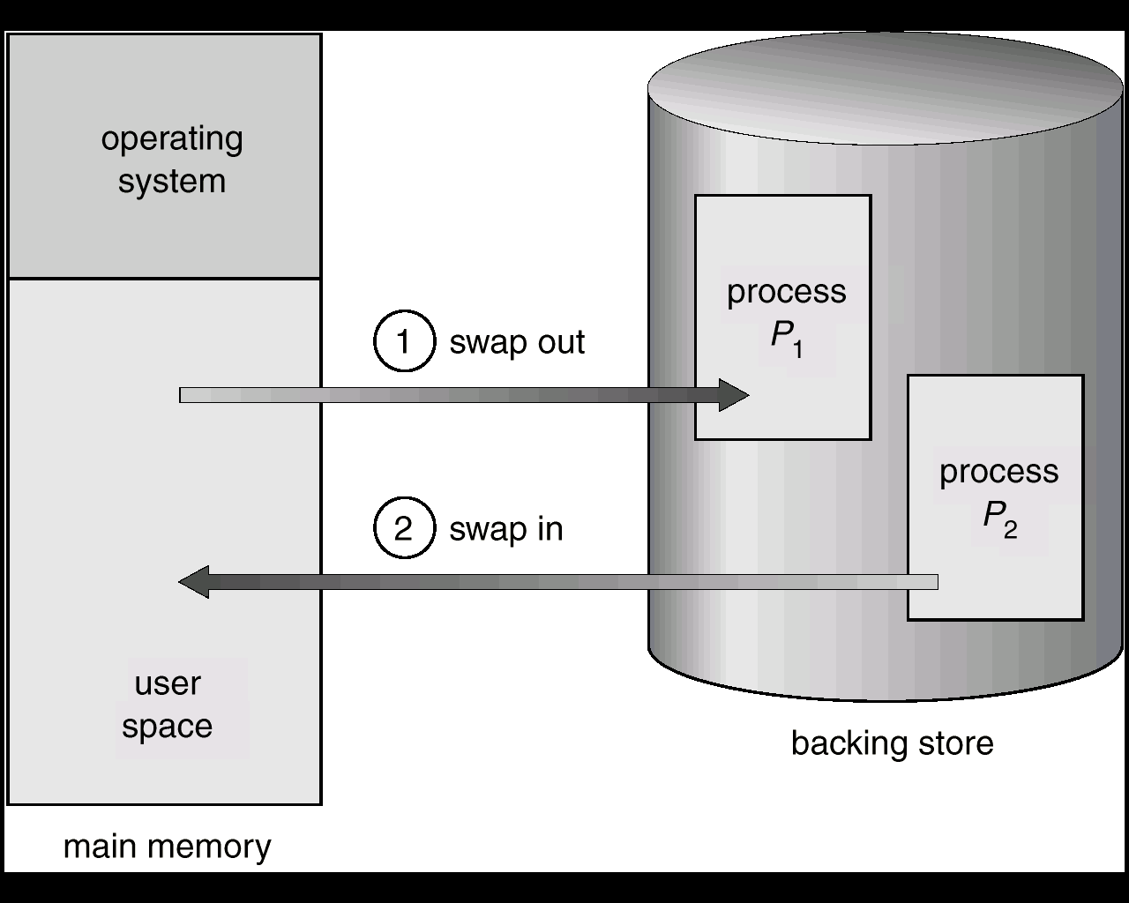
Schematic View of Swapping

Slide 9
Relocation
Programmer does not know where the program will be placed in memory when it is executed
While the program is executing, it may be swapped to disk and returned to main memory at a different location (relocated)
Memory references must be translated in the code to actual physical memory address

Slide 10
Program relocation
How does a simple MMU scheme performs relocation?
A relocation register is present
The value in the relocation register (starting address) is added to every address generated by a user process at the time it is sent to memory
The user program generates logical addresses; it never sees the real physical addresses

Slide 11
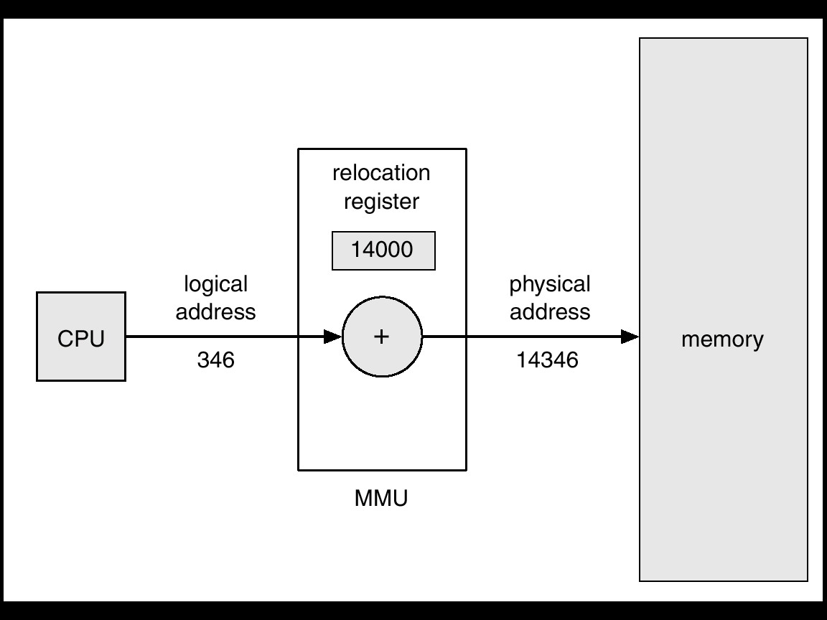
Dynamic relocation using a relocation register
Logical addresses range from 0 to max.
Physical addresses range from R+0 to R+max

Slide 12
Protection
Relocation-register scheme used to protect user processes from each other, and from changing operating-system code and data.
Relocation register contains value of smallest physical address; limit register contains range of logical addresses – each logical address must be less than the limit register

Slide 13
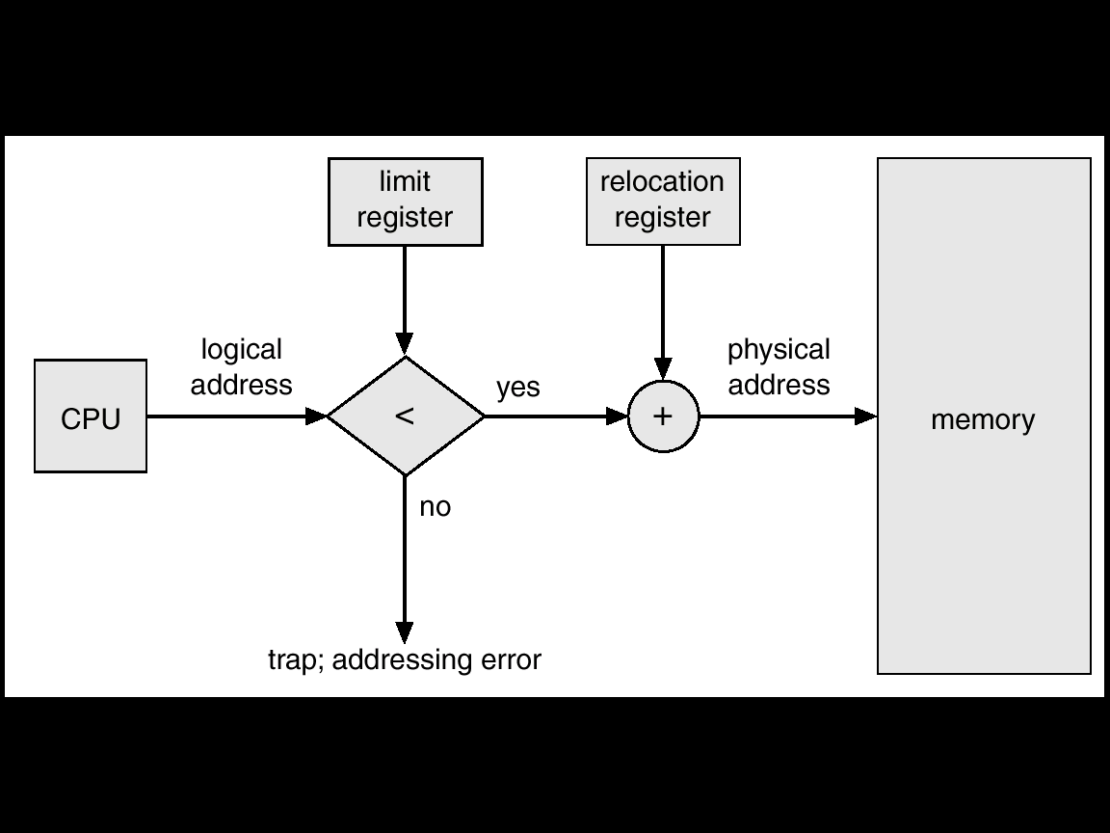
Hardware Support for Relocation and Limit Registers for protection

Slide 14
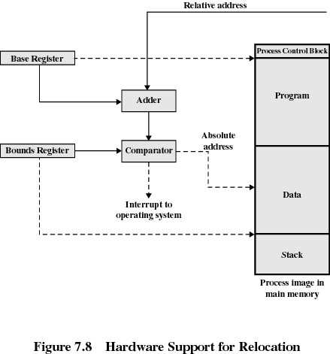
Hardware Support for Relocation and Limit Registers for protection

Slide 15
Contiguous Memory Allocation
Allocates single contiguous section of memory to a process
Single partition
Main memory usually divided into two partitions:
Resident operating system, usually held in low memory with interrupt vector
User process then held in high memory
Only one process/job is kept in main memory

Slide 16
Contiguous Allocation
Multiple-partition allocation
Motivation: Multiple processes/jobs are kept in memory
Fixed sized partitions
Memory divided into several fixed sized partitions
When a partition is free, a process is selected from the input queue and is loaded to the free partition
Types
Equal and unequal partitions

Slide 17
Contiguous Allocation
Equal-size partitions
Any process whose size is less than or equal to the partition size can be loaded into an available partition
If all partitions are full, the operating system can swap a process out of a partition
Unequal-size partitions
Can assign each process to the smallest partition within which it will fit
Processes are assigned in such a way as to minimize wasted memory within a partition

Slide 18
Contiguous Allocation
Disadvantages (Fixed partition)
A program may not fit in a partition if its size is greater than the size of available partition
Main memory use is inefficient. Any program, no matter how small, occupies an entire partition. This is called internal fragmentation

Slide 19
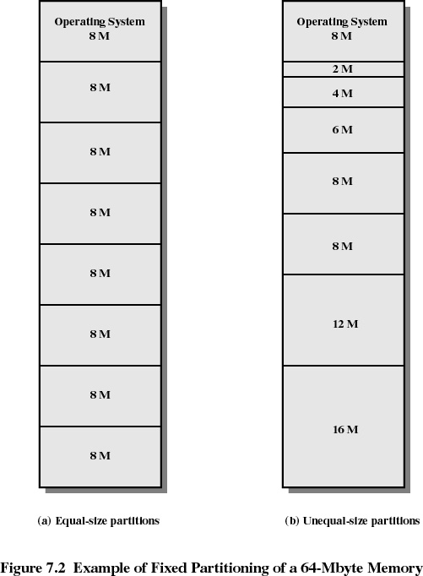
Contiguous Allocation

Slide 20
Contiguous Allocation
Dynamic partition allocation
Partitions are created dynamically as processes enter and leave main memory
Hole – block of available memory
Operating system maintains a table that holds information about: a) allocated partitions b) free partitions (hole)
When a process arrives, the table is searched for a large enough hole and if available it is allocated to the process
When a process terminates, the space is freed and is added to the set of holes
Adjacent holes can be combined to form a single large hole

Slide 21
Contiguous Allocation
Disadvantages
Suffer from external fragmentation
Holes of various size are scattered throughout memory
Total memory space exists to satisfy a request, but it is not contiguous
Compaction
Reduce external fragmentation
Shuffle memory contents to place all free memory together in one large block
Compaction is possible only if relocation is dynamic, and is done at execution time

Slide 22
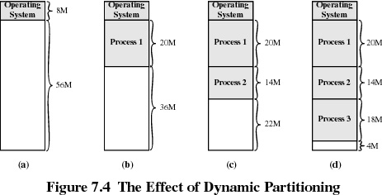

Slide 23
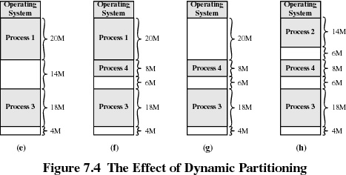
What happens if a process of size 10M comes?

Slide 24
Dynamic Storage-Allocation Problem
How OS satisfies a request of size n from a process given a list of holes?
First-fit:
Allocate the first hole that is big enough
Search for the hole start from the beginning
Next fit:
Search for the hole from where the previous search ended
Best-fit:
Allocate the smallest hole that is big enough
Produces the smallest leftover hole

Slide 25
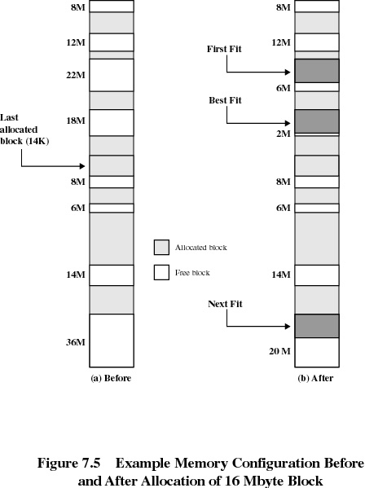
Before and after allocation of 16Mbyte Block
First fit, best fit and next fit

Slide 26
Dynamic Storage-Allocation Problem
Worst-fit:
Allocate the largest hole
Produces the largest leftover hole
Search entire list or order list of holes based on size

Slide 27
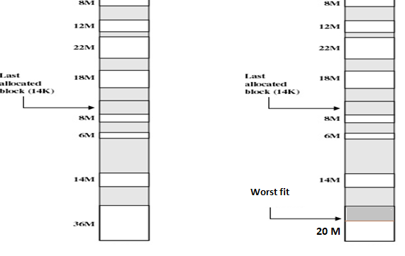
Worst fit

